Slide 1



"Serious" B2B marketing sup port starting with webinars Introduction to Majisemi
For those considering Majisemi for the first time
Seminars strong in attracting customers
No.1
Seminars strong in acquiring new business negotiations
No.1
Seminars chosen by IT managers
No.1
Survey by Japan Marketing Research Organization Overview: 2021 Service Comparison Impression Survey

Slide 2
Introduction
Purpose of today's meeting
For companies considering "Majisemi" for the first time, we will discuss the following topics.
Hearing about marketing challenges
How to utilize Majisemi?
©2018 MAJISEMI Inc.

Slide 3
Hearing
©2018 MAJISEMI Inc.

Slide 4
Hearing
Issue Identification
■ About the products you want to introduce in the seminar
・Which products or services?
・Who is the target audience (people you want to invite to the seminar)?
・Industry, company size, department, position, etc.
※ Majisemi's areas of expertise are "IT departments, DX departments, security departments across all industries, and production/manufacturing departments in factories"
・What are the competing products?
・What are the strengths and differentiation points against competing products?
©2018 MAJISEMI Inc.

Slide 5
Hearing
Issue Identification
■ On the necessity of seminars (webinars)
・What is prioritized as a means of lead acquisition?
・Seminars (webinars)
・Websites (content marketing)
・リアル展示会
・比較サイト
・GoogleやFacebookなどへの広告
・テレアポ
・その他
■予算の状況
・リード獲得単価、アポ獲得単価
・セミナー（ウェビナー）の予算の有無、及び金額
・上記リード獲得手段の予算の割合
・予算の策定、決定時期
©2018 MAJISEMI Inc.

Slide 6
Hearing
Issue Identification
■セミナー（ウェビナー）の目的／課題
・より多くのリードを獲得したい／集客できない
・ターゲットに合ったリードを獲得したい／リードの質が悪い
・ウェビナーから商談につなげたい／商談につながらない
・ウェビナーの運営を代行してほしい／運営が大変
・まずはスモールスタートでウェビナーをやってみたい
・その他
・ウェビナーを活用した、東南アジアにおける新規顧客開拓やテストマーケティング
©2018 MAJISEMI Inc.

Slide 7
なぜ「ウェビナー」なのか？
©2018 MAJISEMI Inc.

Slide 8
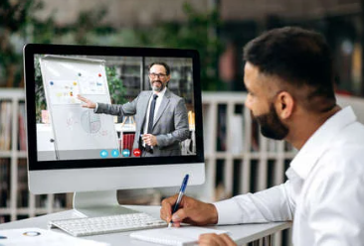

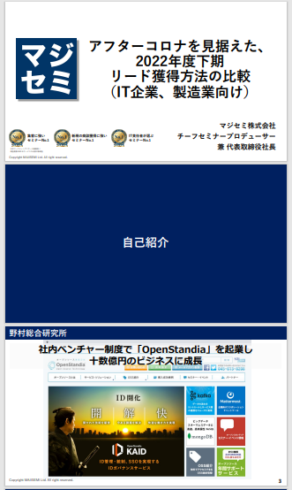
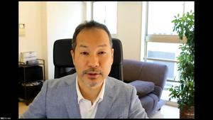
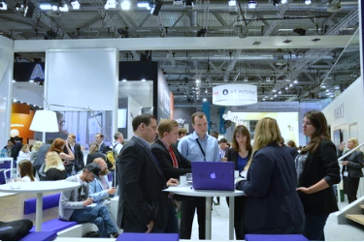
BtoBマーケティングにおけるウェビナーの役割
Webinar
as a Service
Lead Acquisition
Lead nurturing
Proposal and order
課題に
気づいてない
課題に気づき
社内で検討
製品・サービスの
候補を捜す
製品・サービスを絞って
評価・選定、稟議
課題に気づかせる
課題について深く理解させ、
解決方法を提示する
競合よりもお客様に早く接触し、課題解決をサポートする
数社～十数者程度の検討の候補に入り、２～３社の最終候補に残る
２～３社の最終候補から自社を選んでもらう
Utilization of webinar content
課題に気づかせる。
課題について深く理解させる。
競合よりもお客様に先に接触し、自社を知ってもらう。
When holding a webinar,
a lot of content is generated
● Presentation materials → White paper
● Presentation video → YouTube, social media
● Presentation content → SEO articles, blogs
Webinar
Field sales
Webサイト
Content marketing
Webinar
Social media advertising
Deepen understanding of issues.
Also provide competitive comparison information and information about our products.
For nurturing existing leads.
リアル展示会
オンラインイベント
Document download
Field sales
©2018 MAJISEMI Inc.

Slide 9

Email advertising
Positioning of webinars in lead acquisition
planning
Cost per lead
Telemarketing
¥30,000
Webinar
リアル展示会
Listing/Social media advertising
Visitor
14,500 yen
Majisemi
Club
¥10,000～
¥10,000
Online
Exhibition
(Large-scale webinar)
Comparison site
Document download
On-demand
Video distribution
¥5,000
リアル展示会
Joint exhibition
Low
Interest
High
©2018 MAJISEMI Inc.

Slide 10
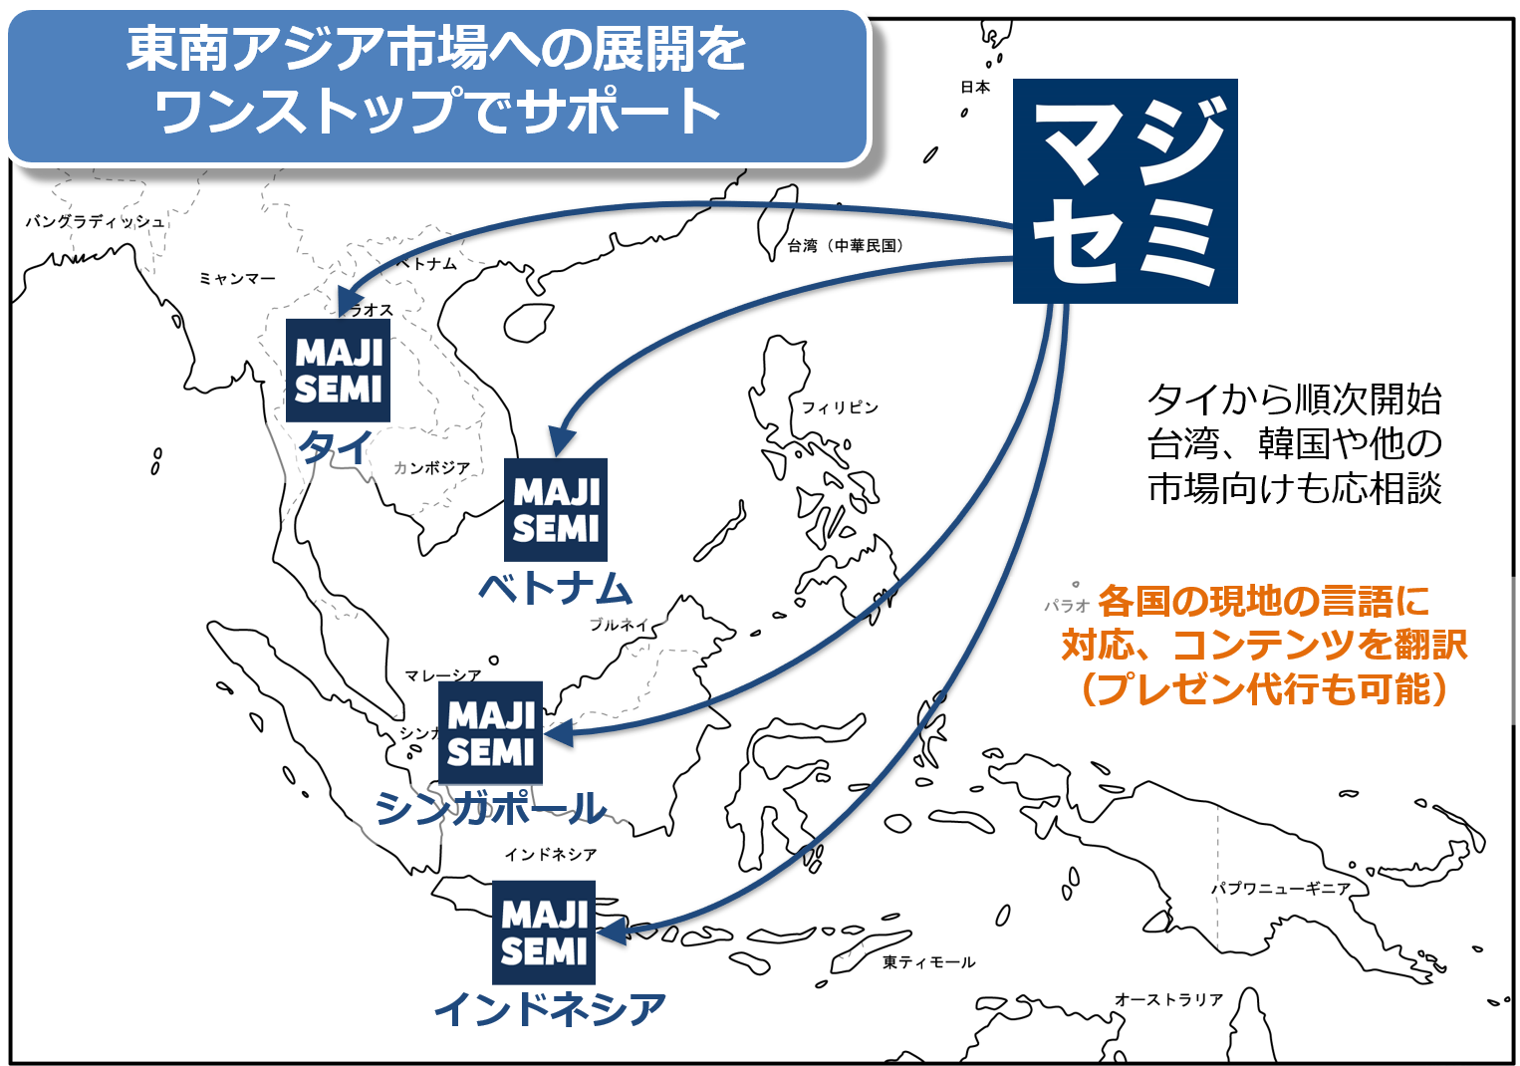
Support for expansion into Southeast Asia using webinars
planning
Webinars can be delivered to Southeast Asia at almost the same price as for Japan.
Your company only needs to prepare a presentation video (and slides) in Japanese (or English).
Majisemi handles everything from adding subtitles in local languages, translating slides, to the day of delivery.
Options include post-webinar lead follow-up and secondary use of webinar videos with local language support.
Promoting joint exhibitions at trade shows held in Southeast Asia.
©2018 MAJISEMI Inc.

Slide 11


Why start with a webinar?
planning
Cold calls or direct mail from no prior contact can lead to distrust.
First, by holding webinars that "provide valuable information," you can establish the initial contact and
gain "trust and credibility."
Features of webinars
When emailing the entire list
Can provide an "interactive experience"
Live Q&A
Demos and factory tours while receiving questions and requests
Can obtain "live feedback"
Pre/post surveys, as well as polls and questions during the presentation
Can attract viewers with "high interest"
In small webinars, people troubled by issues your products/services can solve will participate
Build trust by "sharing the space"
Recognized as a "teacher"
Building trust through communication such as Q&A
0.7%
70%
Response rate when materials are sent by email
is about 100 times!
When emailing seminar participants
Face-to-face communication with customers,
increasing trust and c redibility
Response to subsequent follow-up
Differs by about 100 times
※According to our research
©2018 MAJISEMI Inc.

Slide 12
Overview of Majisemi's services
©2018 MAJISEMI Inc.

Slide 13
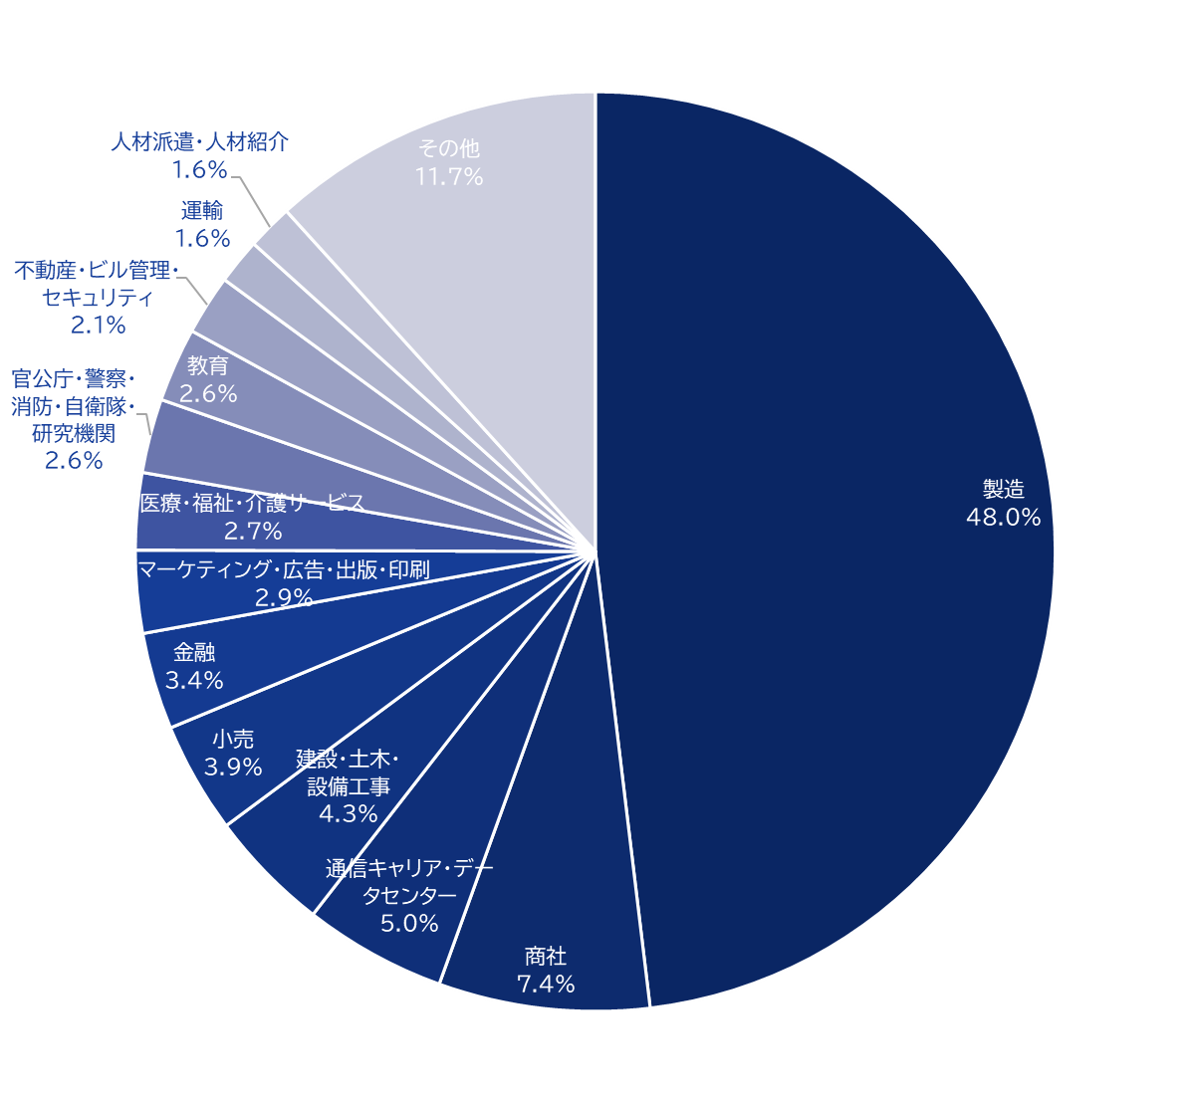
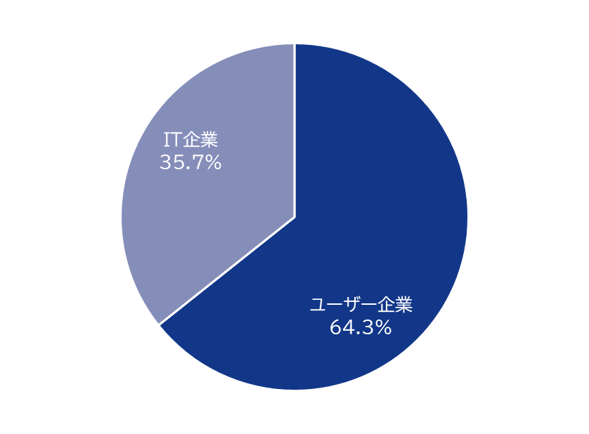
Majisemi's house list
Webinar
as a Service
Attracting customers
Approximately 250,000
House List Owned!
Breakdown of user companies
House
List
Overall
*Estimated from seminar applicants from 2020 to 2024
©2018 MAJISEMI Inc.

Slide 14
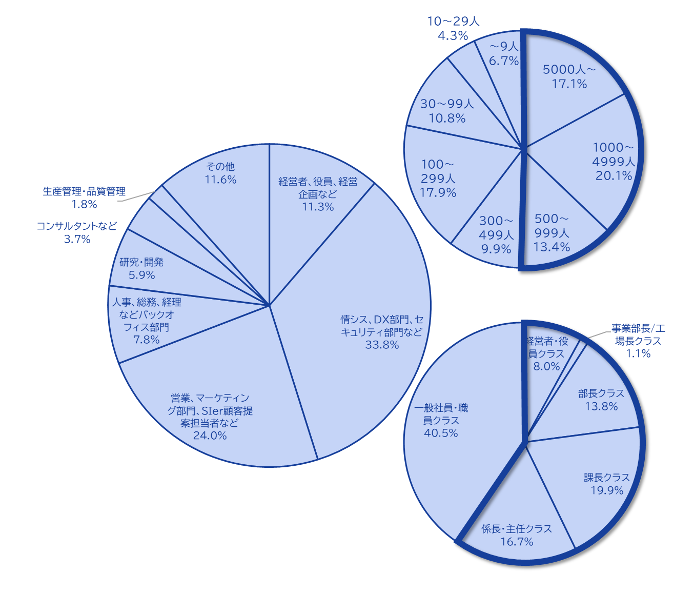
Majisemi's house list
Webinar
as a Service
The Majisemi list is
almost exclusively focused on the following attributes.
Nearly half work at
large corporations
Company
Size
All industries × Information Systems Department, DX-related Department
All industries × Security Department
Manufacturing × Production/Manufacturing Department
All industries × Back Office Department
IT Companies × All Job Types
Job Type
House List Breakdown
At Majisemi, to ensure that participants in your webinars are better matched to your products and services, we do not use attribute specification (segmentation) when attracting participants via email, etc.
Instead, we design the webinar theme (title, announcement text)
on the Majisemi side,
adopting a method to increase the proportion of your target audience.
Emails are not sent to all contacts, but prioritized for those highly interested in the set theme.
Position
Primarily managers
©2018 MAJISEMI Inc.

Slide 15





Why is it necessary to hold webinars?
Webinar
as a Service
The value of cold leads and the importance of repeating webinars
Lead Acquisition
Nurturing & Business Negotiations
Contract
1 person
Hot leads
3 people
Seminar Held
30 people
Cold Lead
21 people
Repeatedly held
is important!
27 people
Including past participants, repeatedly holding webinars
to efficiently acquire new leads and nurture them.
If left unattended
21 people
80% contract with
competitors within 2 years
Majisemi conducts long-term follow-up with past participants,
and also offers 'MajiFollow Plus' to assist in appointment acquisition.
(SiriusDecision survey)
©2018 MAJISEMI Inc.

Slide 16








Reasons to use Majisemi
Webinar
as a Service
Outsource your webinar operations
Repeat PDCA to explore winning patterns
Planning
Attracting attendees
Seminar
Secretariat
Moderation
Appointment acquisition
(Optional)
Survey aggregation
Report creation
SEO article creation
Video production
(Optional)
Review &
Improvement
One-stop service
from start to finish
Majisemi handles it all, so
All support included
with only the cost of attracting attendees!
Focus on the presentation
on the day!
©2018 MAJISEMI Inc.

Slide 17

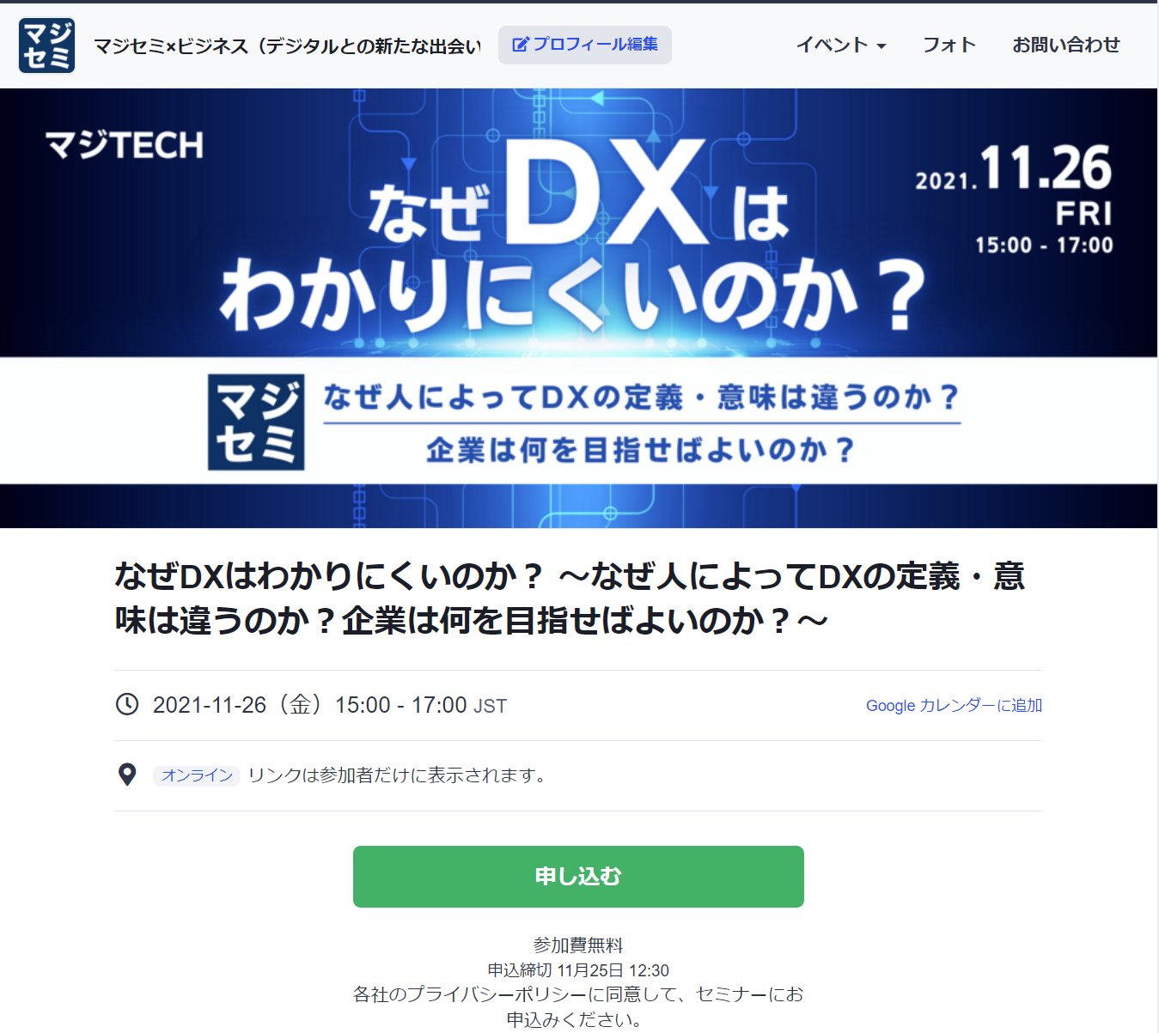
Reasons to use Majisemi
Webinar
as a Service
In a single webinar, it is possible to acquire new leads and nurture existing leads simultaneously
Create and publish attendee page
Attracting attendees
Majisemi management screen
1-week and day-before reminder distribution
Majisemi attendee slots
Attract customers with Majisemi
Majisemi slot
Applicant data
Participation URL distribution
Plan finalized
To your company's customer acquisition slot
Applications are
not charged regardless of the number of people!
For nurturing your existing
house list,
reviving dormant customers,
and acquiring new leads through your website, etc.,
please make full use of it!
Your attendee slots
After publication
URL
will be provided
Attract customers through your company's house list, website, etc.
Your attendee slots
Applicant data
On the mirror site of the Majisemi customer acquisition slot,
we will create a dedicated customer acquisition site URL for your company.
Deliver all leads to your company
©2018 MAJISEMI Inc.
*Excludes declined applicants and those on the waiting list

Slide 18
Successful webinar case studies

Slide 19
(Case 1) "Changed the theme and achieved over 120 attendees" <Company C>
■ Customer challenges
・SIer focusing on selling server/infrastructure services
・Hosting webinars in-house but unable to attract attendees
・Even when requesting media for customer acquisition, unable to attract attendees
■ Plan utilized
・Visitor (later transitioned to Majisemi Club)
■ Majisemi's response
・Utilized know-how from hosting 1,000 webinars annually and tools like "trend analysis tools " to propose "attractive plans" from Majisemi
■ Result
・Achieved over 120 attendees
©2018 MAJISEMI Inc.

Slide 20
(Case 2) "Explored themes and achieved over 50% appointment acquisition" <Company T>
■ Customer challenges
・Tool vendor
・Focused on marketing through exhibitions, but struggled to convert to business discussions
■ Plan utilized
・Visitor (later transitioned to Majisemi Club)
■ Majisemi's response
・While repeatedly holding webinars, explore "themes that can attra ct a certain level of audience and lead to business discussions."
■ Result
・Attracting around 30 participants each time, improving the conversion rate from 10%→20%→50%
・Presenters themselves conduct follow-ups after the webinar
©2018 MAJISEMI Inc.

Slide 21
(Case Study 3) "Switched to online and acquired 20% appointments" <Company Z>
■ Customer challenges
・A global IT company developing and selling packaged products and SaaS
・Struggling with attracting attendees and attendance rates for offline seminars
・Not leading to business discussions
■ Plan utilized
・Visitor
■ Majisemi's response
・Proposal for online (webinar)
・Implemented "seminar planning that leads to business discussions"
■ Result
・30 registrations → achieved 6 appointments
©2018 MAJISEMI Inc.
‹#›

Slide 22
(Case Study 4) "Acquired over 15% appointments with follow-up outsourcing" <Company I>
■ Customer challenges
・An IT venture company in the infrastructure sector also developing its own products
・Held several webinars with successful audience attraction, but not leading to business discussions
・Staff are too busy to conduct sufficient sales follow-ups after webinars
■ Plan utilized
・Visitor
■ Majisemi's response
・Implemented "seminar planning that leads to business discussions"
・Implemented the follow-up outsourcing service "Majifolo" which makes calls immediately after the webinar ends
■ Result
・50 registrations → achieved 8 appointments
©2018 MAJISEMI Inc.

Slide 23
(Case Study 5) "AI presented and acquired 20% appointments" <Company A>
■ Customer challenges
・Foreign SaaS vendor
・Achieving target audience numbers each time, but not leading to business discussions
・Issues with presentation materials and content
■ Plan utilized
・Majisemi Club
■ Majisemi's response
・Implemented script creation by generative AI and presentation outsourcing by AI digital human
・Implemented the follow-up outsourcing service "Majifolo" which makes calls immediately after the webinar ends
■ Result
・20 registrations → achieved 4 appointments
©2018 MAJISEMI Inc.

Slide 24
Plans and Pricing
©2018 MAJISEMI Inc.

Slide 25
Plan Comparison
Pricing Plans
Recommended
 | Visitor | Majisemi Club Light | Majisemi Club Business Discussion Guarantee
Recommended for these individuals! | Planning to hold webinars 1 to 2 times a year | Planning to hold webinars 4 times or more annually Want to reduce cost per lead | Want business discussions (appointments) instead of just audience attraction Want a guarantee
Cost per lead comparison | 14,500 yen | 12,000 yen (10 people per month) 10,000 yen (for additional audience) | 20,000 yen (30 people over 3 months) 13,500 yen (for additional audience)
Not subject to duplicate charges for past applicants *See each plan description for details | None | Available | Available
Meeting (appointment) guarantee *See each plan description for details | None | None | Available
Contract period | Per session | Monthly (Automatically renewed) | Every 3 months (Automatically renewed)
©2018 MAJISEMI Inc.

Slide 26
Are there any services other than the basic plan that interest you?
Service Map
Limited slots
First-come, first-served
Exhibition
Joint exhibition
Your company's owned leads
(Not subject to charges)
Webinar hosting
Lead follow-up, proposal, and order
Recommended
New service
Presentation script/materials
Creation agency
AI-based presentation agency
Webinar hosting
(Visitor or Majisemi Club)
Follow-up immediatel y after the webinar
(Maji Follow)
Sales outsourcing
(Proposal and order)
(Maji Sales)
Your company's inside sales
or fiel d sales
Recommended
New service
Many companies
Will be utilized
On-demand
Broadcast
Rebroadcast
2-step
Webinar
Many companies
Will be utilized
Utilization of webinar content
Many companies
Will be utilized
Many companies
Will be utilized
Recommended
New service
SEO article
Creation
Full video
Provided/Free
Full video
Provision/secondary use
Summary
Video production
SEO video creation
©2018 MAJISEMI Inc.

Slide 27
Majisemi Club or Visitor?

Slide 28

Plan Comparison
Pricing Plans
Visitor
Seminar Held 30 attendees achieved
Majisemi Club
Seminar Held 30 attendees achieved
(Monthly fee)
10 additional people each month
10 people × @12,000 yen
Attendance slots
10 people
Use the 20-person free bonus
Attendance slots
20 people
Billing
30 people × 14,500 yen = 435,000 yen (excluding tax)
Billing
10 people × 12,000 yen = 120,000 yen (excluding tax)

Slide 29
Majisemi Club initial 20-person free bonus
Campaign
By signing up for Majisemi Club, you can use this bonus at your first event.
You can cancel anytime. Even if you cancel after one session, it's more economical than being a visitor.
Image of hosting using special offers
 | January | February | March | April
Membership fee billing amount | 120,000 yen | 120,000 yen | 120,000 yen | 120,000 yen
Additional attendance slots | +10 people | +10 people | +10 people | +10 people
Campaign-based Additional attendance slots (free) | +20 people | - | - | -
Remaining attendance slots | 30 people | 10 people | 20 people | 30 people
Seminar Held | 30 people | - | - | 30 people
You can purchase additional audience slots at any time
(at a great price of 10,000 yen each)
to host additional webinars
First 20 participants free
Immediately host a webinar for up to 30 participants
Webinar hosting possible
If hosting only once for the first time and canceling at the end of March (notification by the end of February),
Only the membership fee of 120,000 yen x 3 months will be charged.
©2018 MAJISEMI Inc.

Slide 30
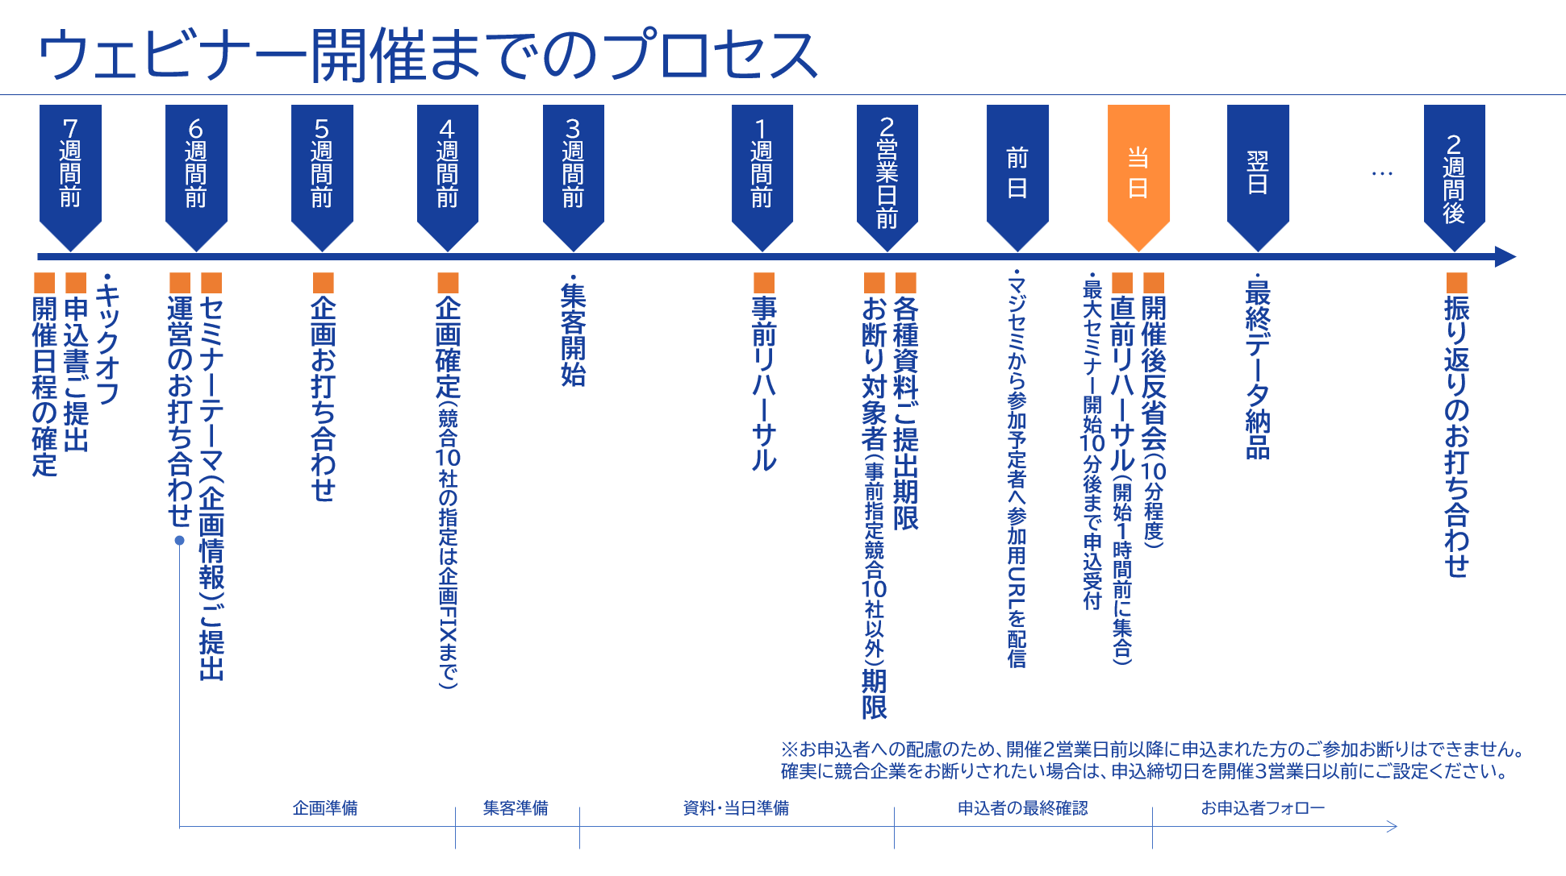
©2018 MAJISEMI Inc.

Slide 31
Take this opportunity to start with Majisemi!
Clients using Majisemi have shared feedback such as
The audience is good,
and it leads to business negotiations.
Awareness has increased, and inquiries from the web
have also increased.
The staff (attendants and cast) are excellent,
making it easier to host seminars.
We have received comments like these.
And most client companies repeatedly host seminars with Majisemi.
However, you may have the following concerns.
"Will the target companies really attend?"
"How much easier will the operation become?"
For such customers,
we offer the 'Majisemi Club Membership First 20 Participants Free' campaign.
Please try Majisemi!
©2018 MAJISEMI Inc.

Slide 32
~Please check later~
(For your reference) Other information

Slide 33


Reasons to use Majisemi
Webinar
as a Service
Outsource your webinar operations
A dedicated planner will create the title and announcement text!
Planning
A Majisemi planner with IT knowledge will work with you to create a webinar plan that achieves audience acquisition and business negotiation.
STEP1
STEP2
STEP3
Formal application
Please enter product name, product information, target, and pain points into the management system.
Planning meeting
Conduct a one-hour meeting online.
Align details based on preliminary information.
Plan finalized
Press the approval button in the management system to finalize the plan.
At our company
Preparation for publishing the
attraction page has
started!!
By email
Confirmation
Attendants (seminar office) will support you until the webinar is hosted!
Attendant
(Seminar office)
Attendants with experience in operating 1,000 seminars annually will accompany you until the seminar is hosted.
Feel free to consult us about any issues!
STEP4
STEP 5
STEP6
On the day
・Moderation
・Collect surveys
Attraction page publication
Create application page
Handle applicants
・Respond to inquiri es ・Send reminders
・Issue participation URL
Rehearsal
・Confirm the flow and requests for the day ・Check the speaker's connection e nvironment ・Confirm preparation status
Report creation
Cast
Cast
©2018 MAJISEMI Inc.

Slide 34
Reasons to use Majisemi
Webinar
as a Service
Dedicated support from the planning stage
Flow of the planning stage
Preliminary preparation
The planning manager will gather information on the seminar theme you share in advance and create appeal point proposals.
Planning meeting
Conduct a meeting for about one hour. Propose appeal points and align details.
Create planning proposal
Based on the content aligned in the meeting, the planning manager will create title and announcement text proposals.
Submit planning proposal
After creating the proposal, the planning manager will submit it via email.
Confirm planning content
Please review the planning proposal content and share any feedback you may have.
Finalize planning
Once the content review and feedback revisions are complete, press the approval button in the management system to finalize the plan.
Preparation for publishing the
Start preparation for publication
©2018 MAJISEMI Inc.

Slide 35
Flow of the event
On the day of the event
Webinar
as a Service
Event time
Distribution tools
General flow of the seminar
Choose from 5 slots
(Weekdays only *No events on weekends or holidays)
The basic duration for one seminar is 1 hour
You can choose from 2 types
*We recommend Zoom for its features and delivery quality
*For seminars hosted by Majisemi, an additional fee applies for events longer than 1 hour (150,000 yen/hour)
10:00-11:00
Registration begins
15 minutes
11:00-12:00
Opening
(Majisemi Cast)
Zoom
Teams
13:00-14:00
5 minutes
Lecture
14:00-15:00
30-40 minutes
Poll
3:00 PM - 4:00 PM
Q&A
(Navigated by Majisemi Cast)
*On Mondays, only the 2:00 PM and 3:00 PM sessions are available
*Majifolo is only conducted at the 10:00 AM and 11:00 AM sessions
*For seminars targeting the manufacturing industry, to avoid theme overlap, they are scheduled at 11:00 AM and 1:00 PM
10-15 minutes
End
©2018 MAJISEMI Inc.

Slide 36
Reasons to use Majisemi
Webinar
as a Service
Effective use of content
Branding & new lead acquisition
Create articles from presentation content
Register on your website, also for SEO measures
SEO article
Create (blog)
During webinar hosting
Reuse content to
Continue lead nurturi ng and new lead acqui sition after hosting
Distributed later exclusively to absentees
Rebroadcast past Majisemi event videos
Effortless event without live presentation
Webinar Hosting
Missed session replay
Rebroadcast
Recorded video
Upload to your own website or YouTube
Summary vid eo creation
On your own website or
Post on your own managed SNS
Webinars or videos other than Majisemi
Secondary use on portals and advertising media
Full vide o provided/free*
Full video p rovided/secondary use*
Lead nurturing
Listed on majisemi.com
Acquire new leads
Majisemi Club Benefits
※Full videos are not provided during the trial, whether free or paid. Howeve r, after the contract, past sessions can be provided regardless of the plan.
Majilead
Document download
©2018 MAJISEMI Inc.

Slide 37
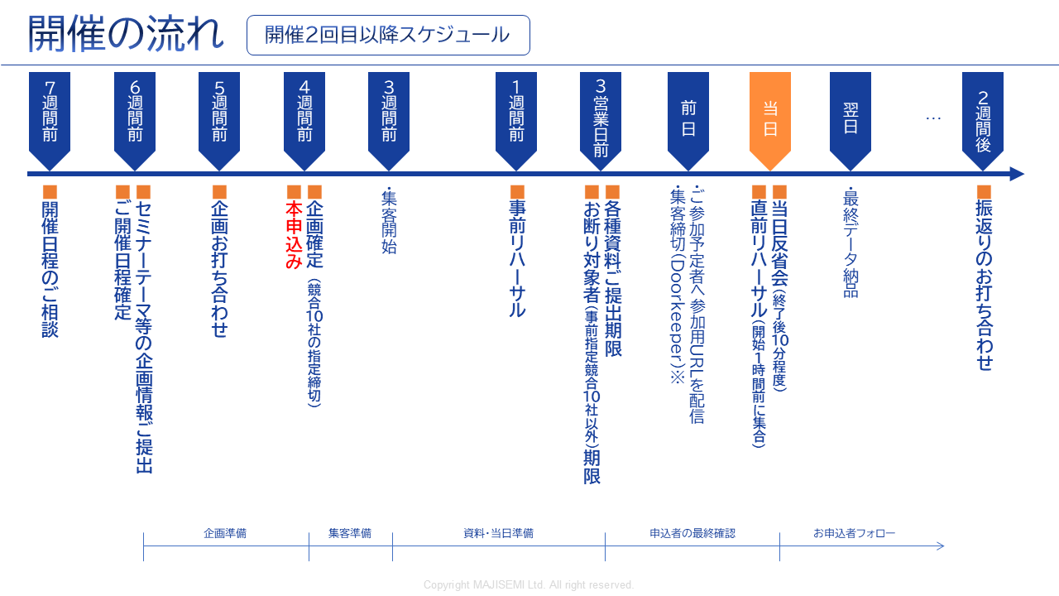
Webinar
as a Service
※To accommodate applicants, we cannot decline participation for those who apply within 2 business days before the event.
If you want to ensure competitors are declined, please set the application deadline 3 business days in advance.
©2018-2024 MAJISEMI Inc.
©2018 MAJISEMI Inc.

Slide 38
Basic Plan
Majisemi Visitor
Plan Details
Reference Plan
Pricing Plans
This is a fully performance-based plan for hosting a one-time webinar.
You can choose from four types depending on how much you want to delegate.
We accept applications from 20 people.
If there are only 10 applicants, you will be billed for only 10 people.
14,500 yen per application (excluding tax)
・ Hosted and applied for each time
・ Performance-based billing according to the number of attendees
・ Applications from 20 people or more
(Billing is only for the number of attendees)
※To accurately track the number of attendees, we will prepare the application page and provide the list to your company.
※Actual billing will be based on the number of applicants up to the maximum number above. If capacity is reached, application acceptance will stop.
※For privacy protection, the list will be delivered directly to the seminar organizer.
※Billing includes not only participants but also absentees (pre-cancellations, day-of cancellations).
※We will strive to attract as close to the maximum as possible, but attendance is not guaranteed.
※Depending on the seminar theme or other concurrent events, there may be cases with no attendance.
Management
Management
Menu |  | Planning | Attracting attendees LP Setup | Moderator | Other Media Import | URL Delivery Reminder | Zoom Provision | Post-event Survey
Majisemi Visitor | Standard | ○ | ○ | ○ | No Other Media Posting | ○ | ○ | ○
 | Planning & Customer Acquisition | ○ | ○ | - |  | - | - | -
 | Customer Acquisition & Management | - | ○ | ○ | - | ○ | ○ | ○
 | Customer Acquisition Only | - | ○ | - | - | - | - | -
Product Name | Content | Quantity | Unit Price (¥) | Amount (¥)
Majisemi Visitor (20 people) | Webinar Planning, attracting attendees, and operation | 20 | 14,500 | 290,000
Visitor Plan Reference Plan for 20 People |  | Subtotal |  | 290,000
 |  | Consumption Tax (10%) |  | 29,000
 |  | Total (Including Tax) |  | 319,000
©2018 MAJISEMI Inc.

Slide 39
Basic Plan
Majisemi Club Light
Plan Details
Reference Plan
Pricing Plans
Monthly Fee: 120,000 yen (excluding tax) ※ Light Plan includes 10 customer acquisition slots
Additional Customer Acquisition Slot @10,000 yen (excluding tax)
Automatic renewal every month
Add 10 customer acquisition slots each month
The minimum capacity for webinars is 30 people
If you hold a webinar with 30 participants in the first month, purchase an additional 20 participant slots (@10,000 yen each)
If the number of participants does not meet the quota, the remaining slots can be carried over to the following months
Additional participant slots can be purchased for @10,000 yen
If someone who has registered for your company's past three seminars (for which fees apply) registers again for the current seminar, that seminar will not be subject to charges (fan development)
Additionally, benefits include providing leads from those who download publicly available presentation materials, offering a branding dashboard, and providing a trend analysis tool
Majisemi Club is a membership service that continuously holds webinars, implementing the PDCA cycle to create better webinars. Admission is subject to screening.
For Majisemi Club, we provide a one-stop service including planning, customer acquisition, moderation, and management. We cannot support only customer acquisition, etc.
Furthermore, the seminar content (planning) will be a "problem-solving seminar" rather than a "product introduction." The product introduction will be conducted in the latter part of the presentation. The seminar content will be decided in consultation with the Majisemi planning members. It may not be possible to hold a seminar on your desired theme. If you wish to decide the theme yourself, please use the Visitor option.
Please note that considering the purpose of the aforementioned Majisemi Club, a penalty will be set for cancellations within one year of contract commencement. (We will charge the difference from the Visitor fee)
※To accurately track the number of attendees, we will prepare the application page and provide the list to your company.
※ If the capacity is reached, we will stop accepting applications.
※For privacy protection, the list will be delivered directly to the seminar organizer.
※ Not only participants but also absentees (cancellations before and on the day) are counted towards the number of attendees.
※ The contract is automatically renewed monthly, and will continue in the same manner thereafter.
※ Upon withdrawal, we cannot refund any remaining customer acquisition slots. Additionally, you cannot rejoin the Majisemi Club for one year after withdrawal.
※ To withdraw, please contact us via email by the end of the month prior to the withdrawal month.
※ Benefits are subject to change.
If you have challenges in converting seminars into business discussions or want to strengthen your website content and SEO, please consider our value set plans mentioned later.
Product Name | Content | Category | Amount (¥)
Majisemi Club Light (30 participants) | Planning, attracting participants, and managing webinars | Monthly fee | 120,000
Majisemi Club Light Plan Attracting 30 participants, If 10 participants are attracted through the monthly fee and 20 through additional slots |  | Additional participant slots | 200,000
 |  | Consumption Tax (10%) | 32,000
 |  | Total (Including Tax) | 352,000
©2018 MAJISEMI Inc.

Slide 40
Basic Plan
Majisemi Club Light
billing pattern
Pricing Plans
Example of holding a webinar and billing with Majisemi Club
add 10 recruitment slots every month
Webinar
Held
Webinar
Held
Webinar
Held
seminars can be held anytime (or not at all)
(target capacity is 30 or more participants, 10 or more for re-broadcasts)
Webinar
Held
 | January | February | March | April | May | June | July | August | September | October | November
Additional attendance slots | +10 | +10 | +10 | +10 | +10 | +10 | +10 | +10 | +10 | +10 | +10
Beginning of the month Remaining attendance slots | 10 | 10 | 20 | 30 | 15 | 10 | 20 | 30 | 40 | 50 | 10
Monthly fee billing | 120,000 yen | 120,000 yen | 120,000 yen | 120,000 yen | 120,000 yen | 120,000 yen | 120,000 yen | 120,000 yen | 120,000 yen | 120,000 yen | 120,000 yen
Seminar Held Target capacity | 30 people |  |  | 30 people | 50 participants |  |  |  |  | 50 participants
Seminar Held Participant results | 30 people |  |  | 25 participants | 48 participants |  |  |  |  | 50 participants
consumption of recruitment slots | -10 |  |  | -25 | -15 |  |  |  |  | -50
end of the month Remaining attendance slots | 0 | 10 | 20 | 5 | 0 | 10 | 20 | 30 | 40 | 0 | 10
Additional participant slots | 20 |  |  |  | 33
Additional participant slots billing | 200,000 yen |  |  |  | 330,000 yen
target capacity is 30 or more participants
holding with 50, 100 participants, etc. is also OK
seminars with 30 participants from the first month are also OK
carry over any shortfall to the next month
any shortfall will be billed at 10,000 yen per participant
there will be no recruitment beyond the target capacity
©2018 MAJISEMI Inc.

Slide 41

Basic Plan
Majisemi Club Business Discussion Guarantee
Plan Details
Reference Plan
Pricing Plans
600,000 yen every 3 months (excluding tax)
Contract automatically renews every 3 months
Guarantee of 30 participants and 3 business negotiations every 3 months
Majifolo is provided for free
In case of shortfall, the shortfall will be carried over to future seminars
For additional events with more than 31 participants, 13,500 yen per participant
If someone who has registered for your company's past three seminars (for which fees apply) registers again for the current seminar, that seminar will not be subject to charges (fan development)
Additionally, benefits include providing leads from those who download publicly available presentation materials, offering a branding dashboard, and providing a trend analysis tool
This is a plan that automatically renews every 3 months. We guarantee 30 participants and 3 business negotiations (appointments).
We handle the planning of seminar content, recruitment, day-of operations, and sending materials to participants on the day.
Majifolo is included in the fee.
If the initial seminar does not meet 30 participants and 3 cases, it will be carried over to that quarter or the next quarter,
We will hold additional seminars. (The basic goal is to achieve it in the first instance)
*To accurately track the number of participants, we will prepare the application page and provide the list to your company.
*If the capacity is reached, we will stop accepting applications.
※For privacy protection, the list will be delivered directly to the seminar organizer.
※ Not only participants but also absentees (cancellations before and on the day) are counted towards the number of attendees.
*The contract is automatically renewed every 3 months, and will continue in the same manner thereafter.
※ Upon withdrawal, we cannot refund any remaining customer acquisition slots. Additionally, you cannot rejoin the Majisemi Club for one year after withdrawal.
*For withdrawal, please notify us by email by the end of the month prior to the withdrawal month.
*We may not be able to accept requests with a guarantee of business negotiations.
※ Benefits are subject to change.
Product Name | Content | Quantity | Unit Price (¥) | Amount (¥)
Majisemi Club event (30 participants) | Planning, attracting participants, and managing webinars | 1 | 600,000 | 600,000
Majifolo (30 participants) | Appointment setting via phone and email for participants | 30 | 3,500 | 105,000
 | All cases are free under the Majisemi Club business negotiation guarantee | 30 | -3,500 | -105,000
Majisemi Club Business Negotiation Guarantee Plan Reference plan for 30 participants |  | Subtotal |  | 600,000
 |  | Consumption Tax (10%) |  | 60,000
 |  | Total (Including Tax) |  | 660,000
Guarantee of recruitment and business negotiations!
©2018-2023 MAJISEMI Inc.

Slide 42
Majisemi Club's Value Plans (Planned Revision)
Pricing Plans
Recommended
 |  | Light | Silver | Gold | Platinum | Premium
Included Services | Webinar hosting | ● | ● | ● | ● | ●
 | SEO article creation | ― | ●※1 | ― | ― | ●※1
 | Majifolo | ― | ― | ●※2 | ●※2 | ●※2
 | Majifolo Plus | ― | ― | ― | ●※3 | ●※3
 | Summary Video | ― | ― | ― | ― | ●※1
Additional Audience Slot Gift (Special Offer)※4 |  | ― | Every year for 10 people Equivalent to 100,000 yen | Every year for 20 people Equivalent to 200,000 yen | Every year for 40 people Equivalent to 400,000 yen | Every year for 80 people Equivalent to 800,000 yen
Monthly fee |  | 120,000 yen | 135,000 yen | 155,000 yen | 255,000 yen | 385,000 yen
Simply a Webinar
Only want to request hosting
Want to utilize presentation content
on the website as well
Want to follow up immediately
after the webinar
Want to reliably connect
webinars to business negotiations
Want to maximize
the effectiveness of webinars
※1 SEO article creation and summary video creation can be conducted up to 4 times a year. Additional options can be purchased for more.
※2 Majifolo can be conducted for up to 120 people a year. Additional options can be purchased for more.
※3 Includes monthly activity costs for Majifolo Plus. A success fee of 30,000 yen per appointment is charged separately.
※4 The additional audience slot gift is granted one year after joining Majisemi Club and every year in the same month thereafter.
(All amounts are tax-exclusive)
©2018 MAJISEMI Inc.

Slide 43
Other options *Please consult us for details
Webinar
as a Service
Name | Price (excluding tax) | Content
Majifolo (Post-seminar follow-up) | @3,500 yen × number of attendees | Majisemi's follow-up specialists will contact participants and absentees via email and phone immediately after the seminar ends.
SEO article creation | 50,000 yen | We will create an article of approximately 3,000 words with SEO in mind based on the seminar content. By publishing it on your website, you can promote content marketing.
Full video provision/paid | 200,000 yen | This is an option to provide seminar videos for secondary use. *We offer it for free within certain usage limits. During the trial, neither paid nor free provision is available.
Summary video creation | 50,000 yen | When posting seminar videos on YouTube, etc., long videos tend to be disliked. Therefore, we will edit and provide a 5-10 minute version.
Missed session replay | 50,000 yen | For those who registered but were absent on the day, we will allow them to view the day's video.
Rebroadcast | @14,500 yen/10,000 yen | Hold additional webinars effortlessly using recordings from past Majisemi events.
Two-step webinar | 200,000 yen | We will plan and hold a theme that leads to more business negotiations (appointments) for those who have previously registered for your webinars (your prospects), such as competitor comparisons, product introductions, demos, etc.
Operational support (operation outsourcing) | 200,000 yen | We will manage your seminar operations. We handle tasks such as creating the registration page, managing registrants, lending Zoom, and moderating on the day. (Attracting attendees is not included. You will need to handle that.)
Presentation by Majisemi representative Terada Presentation at your seminar | 300,000 yen～ *Approximately 30 minutes to 1 hour | Majisemi representative Terada will facilitate presentations, discussions, and panel discussions at your seminar. Please consult us about the theme.
Keynote speech by 'Evangelist AI' Digital Terada | 100,000 yen | 'Evangelist AI' Digital Terada, utilizing generative AI, will deliver a keynote speech at your webinar. - Want to give a seminar but lack time to create a script or slides - No skilled presenters among employees (or they are too busy), so want to outsource the presentation as well
SEO video creation | 50,000 yen per video～ *In units of 10, excluding initial costs | This is a strategy to aim for top rankings in YouTube and Google video searches. Majisemi will create a custom AI avatar for your company and produce video content explaining terms. Scripts can also be delivered, and blog utilization is possible.
Product comparison video creation | 500,000 yen～ *Excluding initial costs | We will create a competitive product comparison video to strongly recognize the strengths of your product. Majisemi will create a custom AI avatar for your company and produce product comparison video content. It can also be distributed in webinars.
©2018 MAJISEMI Inc.

Slide 44
Notes
Webinar
as a Service
■ Generally, meetings start 6 weeks in advance, and the formal application is made 4 weeks before the event.
Additional charges
Cancellation fee
For all services, if you cancel after making a "formal application" through Majikan (Majisemi management screen) or after we receive the order form/application form, a 100% cancellation fee will be charged.
However, for webinar events, the cancellation fee is capped at the equivalent of 20 visitors for general visitors and 30 slots for Majisemi Club members.
For Majifolo, the cancellation fee is capped at the equivalent of 20 visitors for general visitors and 30 slots for Majisemi Club members.
If adjustments to the title, announcement text, etc., are delayed and the webinar cannot be published by 5 PM, 10 business days before the event date, it will be considered a cancellation and the above cancellation fee will be charged.
Upon withdrawal from Majisemi Club, no refunds will be given for remaining slots.
Considering the purpose of Majisemi Club, if you cancel within one year of starting the contract, a penalty will be applied. Please understand. (The difference from the visitor fee will be charged.)
Majisemi Visitor
Orders placed less than 4 weeks before the event will incur a surcharge.
 | Unit price (excluding tax) | Upper limit specification
Basic fee (Orders placed more than 4 weeks before the event) | 14,500 yen | 20 or more
Orders placed less than 4 weeks before the event | ×1.25 times surcharge
Orders placed less than 3 weeks before the event | ×2 times surcharge
Various Majisemi Club
If the formal application cannot be made 4 weeks before the event, there is no surcharge, but the event will be postponed upon consultation.
©2018 MAJISEMI Inc.

Slide 45
Majisemi Co., Ltd.

Slide 46

Company name
Headquarters location
Representative name
Business description
Seminar hosting achievements
Established
Capital
Number of employees
Majisemi Co., Ltd.
3rd Floor, Shiodome Building, 1-2-20 Kaiga n, Minato-ku, Tokyo 105-0022 Yuichi Terada
Operation of the IT and manufacturing industry specialized seminar marketing service "Majisemi"
Last year's achievements: Approximately 1,000 events held, total attendance of about 60,000 people (2023)
January 2018
10 million yen
45 employees
About Us
Company overview
Creating opportunities for new encounters and experiences with digital-related products and services to promote the development of domestic industries and the advancement of engineers.
To achieve this, we convey the excellence and potential of technology widely to society, regardless of the size of the providing company.
We clearly communicate to end users not the technology itself, but how it can solve their problems.
By 2025, we aim to host 2,000 webinars annually.
MISSION
セミナーをエンタメに変える
セミナーで社会を変える
おかげ様で３つのNo.１
獲得しました！1
集客に強いセミナーNo.1
IT責任者が
選ぶセミナー
No.1
新規の商談獲得に
強いセミナー
No.1
©2018 MAJISEMI Inc.
日本マーケティングリサーチ機構調べ調査概要:2021年サービスの比較印象調査

Slide 47
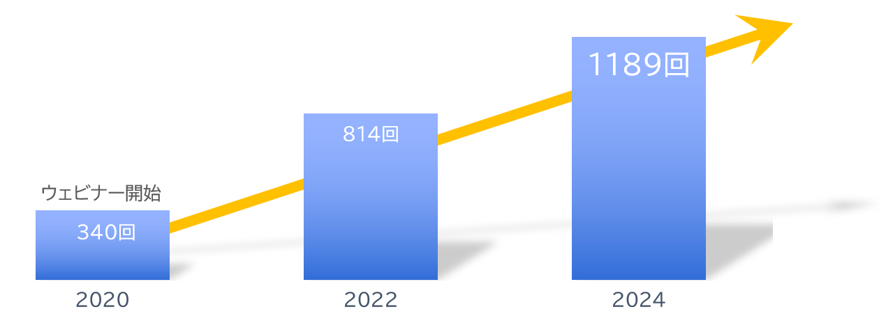
About Us
With clients
Number of seminars held
Increasing every year!
A10ネットワークス株式会社
アイテック阪急阪神株式会社
アドバンテック株式会社
株式会社アクシオ
株式会社アシスト
伊藤忠テクノソリューションズ株式会社
株式会社インターネットイニシアティブ
インフォコム株式会社
エクイニクス・ジャパン株式会社
SCSK株式会社
エフセキュア株式会社
エムオーテックス株式会社
エンカレッジ・テクノロジ株式会社
エントラストジャパン株式会社
株式会社オージス総研
株式会社オプロ
クリックテック・ジャパン株式会社
クロス・ヘッド株式会社
KCCSモバイルエンジニアリング株式会社
株式会社サーバーワークス
サイオステクノロジー株式会社
サイバートラスト株式会社
株式会社ジール
CTCシステムマネジメント株式会社
株式会社システナ
シンガポールテレコム・ジャパン株式会社
GMOグローバルサイン株式会社
JBサービス株式会社
スターティアレイズ株式会社
Smart Style Co., Ltd.
Sumitomo Electric Information Systems Co., Ltd.
Zoho Japan Corporation
Soliton Systems K.K.
Dynatrace
TIS Inc.
Techvan Co., Ltd.
TechMatrix Corporation
Delivery Consulting Inc.
Dell EMC
NSW Inc.
Hulinks Inc.
Netskope Japan Co., Ltd.
Pasona Tech, Inc.
Nippon Telegraph and Telephone East Corporation
Fujitsu Limited
Fujitsu Communication Services Limited
Fuji Electric IT Solutions Co., Ltd.
Mitsubishi Electric Information Systems Corporation
Mirantis Japan G.K.
Monstar Lab, Inc.
Red Team Technologies Inc.
Rosetta Corporation
(Agency)
MM Research Institute Ltd.
Creative Bank Inc.
Target Media Co., Ltd.
Nikkei Advertising Inc.
Bigbeat Inc.
Mynavi Corporation
取引実績
Major clients only, in alphabetical order
©2018 MAJISEMI Inc.

Slide 48
集客に強いセミナーNo.1
No.1 seminar for acquiring new business negotiations
No.1 seminar chosen by IT managers
Survey by Japan Marketing Research Organization Overview: 2021 Service Comparison Impression Survey
セミナーをエンタメに変える
セミナーで社会を変える

